Slide 1
Buyer Persona Template
Create your own buyer personas in a few easy-to-follow steps

Slide 2
What Are Buyer Personas?
Before you sell anything, you need to know who you are selling to. Without this information, you are far less likely to convince the buyer to part with their money. Crucially, you’ll get to know them in advance so that you can speak their language and appeal to their interests.
Buyer personas are fictional, hypothetical representations of your typical customers.
They are created through detailed market research about your customers’ buying traits. Using a variety of techniques, you create your ‘ideal customer’ so that you know exactly who you are dealing with. This often includes their demographics, motivations, occupation, education, and the challenges and struggles that they face. Essentially, this is a way to target specific areas of your audience and pinpoint exactly what makes them purchase a product or use a service.

Slide 3
How Do You Create Buyer Personas?
Creating a buyer persona begins with answering a predetermined set of questions that will help you understand who your potential customers are, what their pain points are, and how you can address these.
Answering these varied questions is not the only ingredient to an ideal buyer persona. It is just as important to choose the right people to answer the questions. We always recommend selecting employees across the business to help create your buyer personas. Furthermore, the research you conduct can vary depending on your business, how long you have been running, and what information you hold on your customers.
For example, if you already have detailed data on your customer base, it will be far easier to align your buyer persona. By matching your existing data with the answers on the buyer persona template, you can begin to form patterns and are one step closer to a complete buyer persona.

Slide 4
Key Questions
In order to define your buyer personas you will need to ask some key questions:
Personal background: What is their age, gender, marital status, location, job title, income, etc.?
Lifestyle: What are their interests, hobbies, favorite sites/apps/social channels?
Problems: What problems do your potential customers have that your solution could help solve?
Goals: What are the goals that your product could help push the buyer towards?
Challenges: What are the challenges your buyer persona will have to overcome to buy your product?
Funnel position: Where is your buyer persona in the purchase funnel?
How you define your buyer personas depends on your business and industry. On the next slides, you will find two different templates, one for B2B and one for B2C.

Slide 5
Define Your Buyer Personas (B2B Template)
Buyer Persona Name:
Key Questions | Answers
Personal background: WHO is the persona? What traits characterise her?
Job title/role: WHAT role does she play?
Typical challenges/problems/goals: WHAT challenges does she face and what goals does she have?
Needs gap: WHERE is there a gap in her needs/wants?
Funnel position: WHEN does she need to close this gap?
What she cares about: WHY should she care about your product/company?

Slide 6
Define Your Buyer Personas (B2C Template)
Buyer Persona Name:
Key Questions | Answers
Personal & business background: Age/generation, marital status, residence, education, profession, financial situation
Lifestyle: A day in the life, hobbies, activities, family, pets, friends etc
Online behaviour: Favourite sites/apps/social channels, shopping behaviour
Hopes & dreams: What would make her life easier/better?
Worries & fears: What is she trying to avoid?
Influencers: What/who influences her?
Needs gap: Where is there a gap in her needs/wants?
Funnel position: When does she need to close this gap?

Slide 7
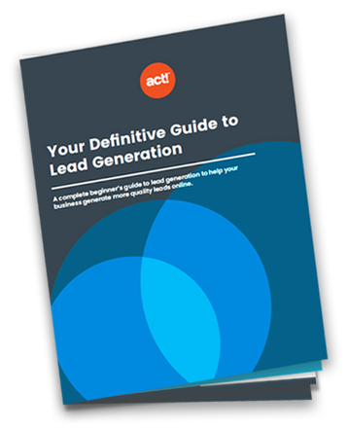
Now It’s Your Turn…
You can use the templates on the previous slides to create your own buyer persona. If you want to create more buyer personas, simply right click the slides and select “Duplicate Slide”.
Want to learn more about how to attract more prospects and generate more quality leads online? Download your free Lead Generation eBook here.

